Slide 1
Word Roots: Classics 30
Wednesday,
August 4, 2010: Unit 1

Slide 2
Today’s Goals
To make clear what will be on the quiz tomorrow
To review material from Unit 1
To learn a bit more about Greek writing
Breathings
Accents
Diphthongs
Nasalized gamma
Problem letters (theta, phi, chi)

Slide 3
Tomorrow’s Quiz
Be able to give me a brief account (three or four sentences) about the spread of Greek and Latin (times and places).
Be able to very briefly explain English’s origin as a Germanic language.
Be able to give correct answers from the Unit 1 questions (pp. 1-32) and exercises (pp. 35-38).
Be able to explain the words at the top of page 34.
Be able to write out the Greek alphabet (including both forms of sigma.
Know what morphemes the underlined biological terms at the end of this lecture come from.

Slide 4
Terms from Top of p. 34, part I
allomorphs
analyze
Anglo-Saxon
base
borrowings
content word
derivative
empty morpheme
etymology
full morpheme
function word
intensifying morpheme
Middle English
morpheme
obsolete
Old English
prefix
structure
suffix
word order

Slide 5
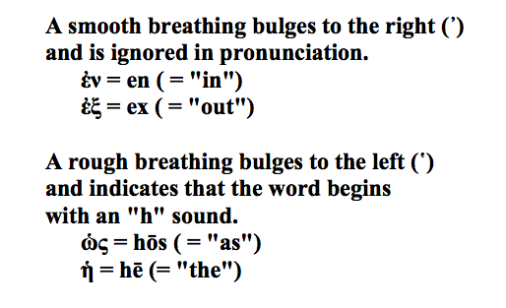
More on Greek Writing: Breathings
Words that begin with vowels in Greek always have a breathing written over their beginning. A breathing is a little mark that looks like like an apostrophe.

Slide 6
More on Greek Writing: Accents
Most Greek words have an accent mark over one of their syllables. There are three kinds:
We won’t worry about accents in this course. They are complicated, not clearly understood, and not important for our purposes. Just be aware of them.

Slide 7
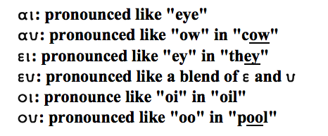
More on Greek Writing: Diphthongs
Diphthongs (from Greek di-, “double,” and phthongos, “sound”) are two vowels that blend into one sound. Here the common Greek diphthongs:

Slide 8
More on Greek Writing: Nasalized Gamma
When gamma comes before another gamma or before a kappa, a chi, or a xi (these are all pronounced in the same place in the mouth as gamma), it is pronounced “ng” as in “sing.” We call it nasalized because it is pronounced through the nose. In English, we write this sound with an “n” (in this, we are copying the Romans, who changed these gammas into ‘n’ when they borrowed words from Greek).

Slide 9
More on Greek Writing: theta, phi, and chi
The Greeks had two “k” sounds, two “p” sounds, and two “t” sounds.
[Native English-speakers have trouble hearing the difference since they use both forms of “k,” “p,” and “t” but think they are the same. For the Greeks they were as different as “p” and “b” or “s” and “z.”]
In each of these pairs, one has a breath of air after it, the other doesn’t, and in each case, the Greeks used separate letters to distinguish them:
When the Romans heard Greeks say phi, theta, and chi, they heard an “h” sound so they wrote the Greek sounds “ph,” “th” and “ch,” and we still transcribe them into English in that way today.
Over the centuries, in Greek pronunciation, phi turned to and “f” sound, theta turned to a “th” sound, and chi turned to a sound like German “ch” or Spanish “j.”

Slide 10
Practice with Greek Writing: Pronounce the Following Words

Slide 11
Bonus Biology Term I
“evolution” from Latin
{e/ex} = “out” (sometimes “up”)
{volve/volut} = “roll”
{ion}, which makes nouns out of verbs.
Compare
involve, convoluted, volute
invent, invention; subtract, subtraction; fuse, fusion

Slide 12
Bonus Biology Term II
“taxon” from Greek
{tax/tact} = “arrange in order”
{on} = a suffix that indicates small or minimal divisions
Compare
syntax, tactic, taxonomy (“nomy” = “management”)
neutron, photon

Slide 13
Bonus Biology Term III
“phylum” from Greek
{phyl} = “race” or “tribe”
{on}
Compare
monophyletic (“mono” = “one”)
polyphyletic (“poly” = “many”)
paraphyletic (“para” = “beside,” “alongside,” “beyond”)

Slide 14
Bonus Biology Term IV
“clade” from Greek
{clad} = “branch”
Compare
cladistics
cladogram ({gram} = “drawing,” “writing”)

