Slide 1
Word Roots: Classics 30
Thursday,
August 5, 2010: Unit 2

Slide 2
Today’s Goals
To understand what “parts of speech” are
To learn basic tests to identify nouns, verbs, adjectives, and adverbs
To get some practice reading dictionary articles, particularly etymologies
To get some practice reading Greek
To look at a few more Bonus Biology Terms.

Slide 3
Parts of Speech The Eight Classical Parts of Speech
Classical [that is, Greek and Roman] grammarians divided words into eight categories. Traditionally, they are called the eight “parts of speech.” Your book calls them “classes of words,” which sounds better in modern English.
In fact, these categories were developed to describe Greek and Latin and sometimes don’t fit English well. However, they are still useful.
The eight parts of speech (or classes of words) are:
verbs | prepositions
nouns | pronouns
adjectives | conjunctions
adverbs | interjections

Slide 4
The Eight Parts of Speech
verbs | prepositions
nouns | pronouns
adjectives | conjunctions
adverbs | interjections
The “parts of speech” in yellow are “content words,” and the textbook concentrates on them because these are the words that build vocabulary.
The ones in black are “function words.” Your book is less interested in them. Nevertheless, we will look at them in this class.

Slide 5
Nouns, Part I
Nouns are often said to be persons, places, and things, but such generalizations can be tricky to use.
Ultimately, if you just practice, you’ll get a feel for what’s a noun and what’s a verb and so on. It’s a very natural thing for humans to do.
Your book gives you two tests to help you figure out what’s a noun:
Morphological
Syntactical

Slide 6
Nouns, Part II: The Morphological Test
Morphology
In the morphological test for nouns, you see if a word can be made plural by changing its form with the morpheme {s}. If it can, it’s a noun.
Warning: This test will not always work!

Slide 7
Nouns, Part III: Examples of the Morphological Test for Nouns
The dog chewed a bone.
Of the words in this sentence, only “dog”
and “bone” can be make plural by changing
their forms with {s} (“dogs” and “bones”)
They are the only nouns in the sentence.

Slide 8
Nouns, Part III: The Syntactic Test
Syntax
In the syntactical test for nouns, you see if a word comfortably fits in the position after words that your book calls “noun markers.” Some noun markers are the, a, many, that, and these.

Slide 9
Nouns, Part IV: Examples of the Syntactical Test
with, horse, accelerate, porkchop, beautifully
Which of these words fit comfortably after the
noun markers like the, a, many, that, and these, and are therefore nouns?

Slide 10
Adjectives, Part I
Adjectives are words that answer the questions “How many?” “Which one?” and “What kind?”
In the expression “Those three hairy tarantulas,” “those,” “three,” and “hairy” are adjectives. Which question does each answer?
Your text also gives a morphological and a syntactical test to find adjectives.

Slide 11
Adjectives, Part II: The Morphological Test
In the morphological test for adjectives, you see if a word can be given the endings “-er” and “-est,” as with the word “sad”:
sadder
saddest
This works with short adjectives; with longer ones, see if they go well with “more,” and “most,” as in the case of “beautiful”:
more beautiful
most beautiful

Slide 12
Adjectives, Part III: The Syntactical Tests
There are two syntactical tests for adjectives.
Do they go well between a noun marker and its noun?
the good horse
Do they go well after the word seem?
The horse seems good.

Slide 13
Adjectives, Part IV Using morphological and syntactical tests, determine which of these words are adjectives.
walk
determine
certain
hopeful
impossible
ugly
through
ornate
pickle
happy
sick
deliver
stupid
tree

Slide 14
Verbs, Part I
Verbs are easy to identify with a morphological test.
English verbs change tense by changing form.
If a word can morphologically change to indicate past time versus present time, it’s a verb (There are only a few exceptions: the verb “hit,” for instance, which has the same form in the present and in the past).
Examples:
I walk, I walked (“walk” is a verb)
I eat, I ate (“eat” is a verb)

Slide 15
Verbs, Part II Using a morphological test, determine which of these words are verbs.
walk
determine
certain
hopeful
impossible
dry
through
ornate
pickle
happy
sicken
deliver
stupid
tree

Slide 16
Adverbs, Part I
Of the four classes of content words (nouns, adjectives, verbs, and adverbs) adverbs are the slipperiest.
Often adverbs are formed from adjectives by adding {ly}:
sad (adjective) => sadly (adverb)
hopeful (adjective) => hopefully (adverb).
However, many adverbs do not end in {ly} and some adjectives do.

Slide 17
Adverbs, Part II
Adverbs have two identifying characteristics:
They answer the questions “How?” “When?” and “Where?”
They modify (describe) verbs, adjectives and other adverbs.

Slide 18
Adverbs, Part III Use the questions “How?” “When?” and “Where?” to identify adverbs in the following list.
sadly
soon
here
motivate
later
quickly
worse
frequently
very
clever
rarely
always

Slide 19
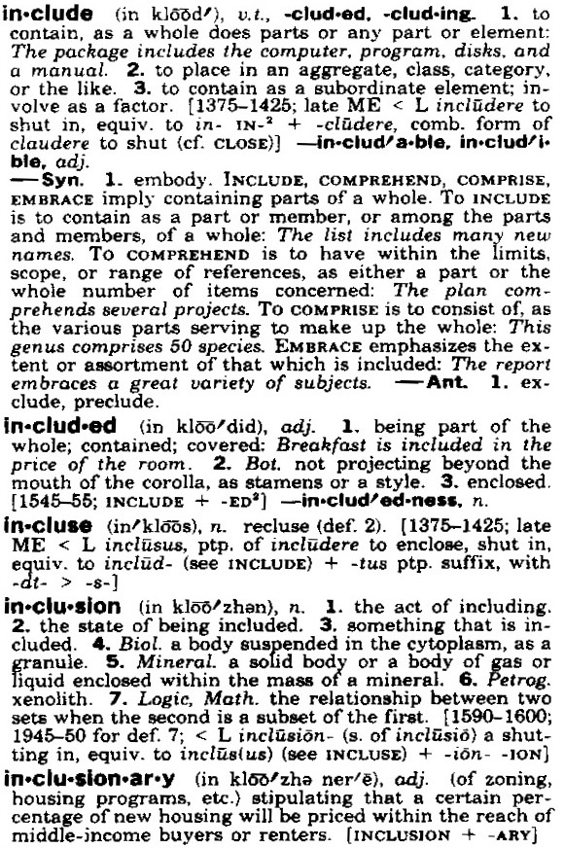
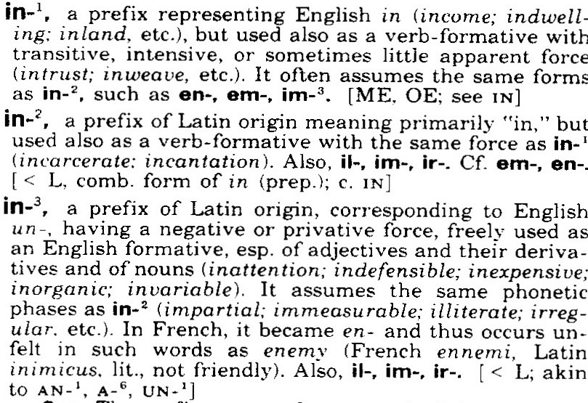
Dictionary Practice I; “inclusion”

Slide 20
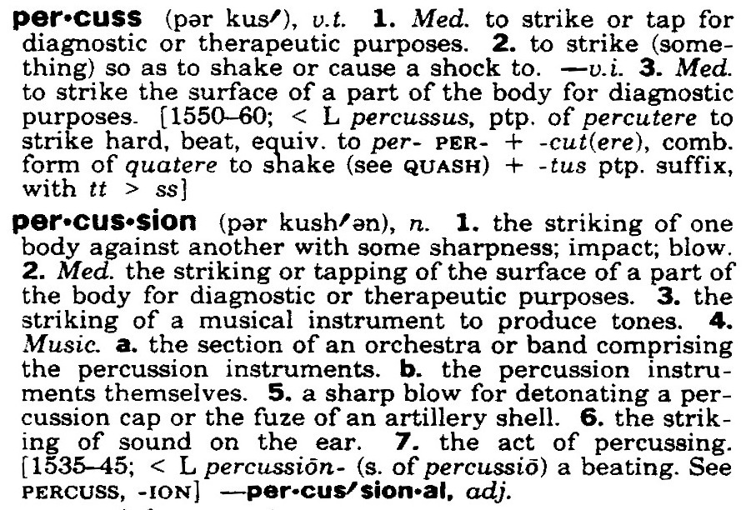
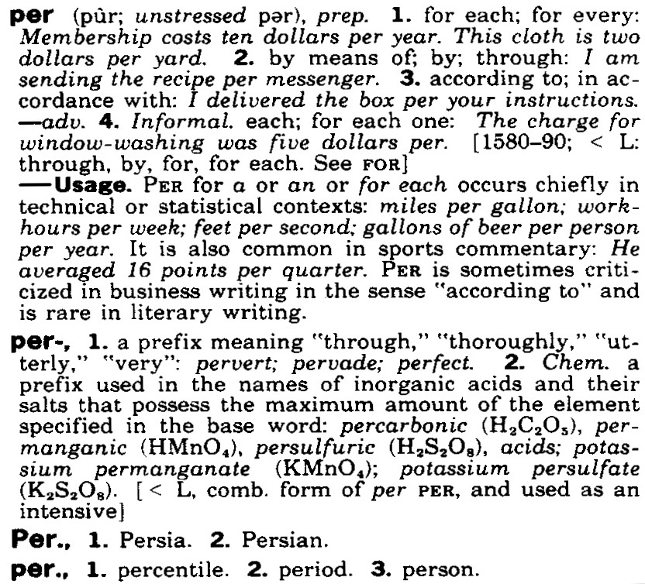
Dictionary Practice II: “percussion”

Slide 21
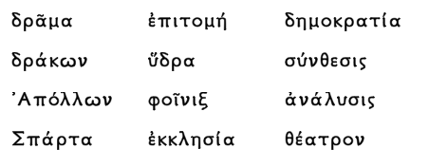
More Greek Practice Read the Following Greek Words

Slide 22
Bonus Biology Term I
Phylogeny = study or description of the “tribal” or “familial” relations of living things
{phyl} (“tribe” or “race”}
{-o-} (connective ‘o’ used in Greek compounds)
{gen} (“producing,” “bearing,” “generating”)
{-y} (makes abstract nouns)
Compare:
Phylogenesis (= phylogeny)
Phylogenetic (adjective)
A Phylogenetic Tree of Life

Slide 23
Bonus Biology Term II
Polytomy = a division into more than two branches
{poly} (“many”}
{tom} (“cut”)
{-y} (makes abstract nouns)
Compare:
Anatomy ({ana} = “up”}
Atom ({a-} = “not”)
Dichotomy (“dicho” = “in two”)
A Polytomy
in a Phylogenetic Tree of Life

Slide 24
Bonus Biology Term III
Homology = similarity, inherited from a common ancestor, between structures (a bird wing and a human arm are homologous forelimbs)
{homo} = “same”
{log} = “word,” “plan,” “structure”
{y} (makes abstract noun).
Etymologically, “homology” means “agreement.”

Slide 25
Bonus Biology Term IV
Homoplasy = presence of similar traits not inherited from the same ancestor, but developed independently (the spines of hedghogs and porcupines are homoplastic, that is, they are and instance of homoplasy)
{homo} = “same”
{plas} = “form,” “shape” (compare “plastic”)
{y} (makes abstract noun).

